Slide 1
Content Strategy for Curefoods' YouTube Channel
Paul Damein K
Data Analyst
Live Project- 1
29 March 2025

Slide 2
Contents:
My 8 video concepts with thumbnails and titles
Analysis of 3 competitors’ YouTube channels
Content structure for each video
When each video should be posted (timeline)
How to measure the success of those videos

Slide 3
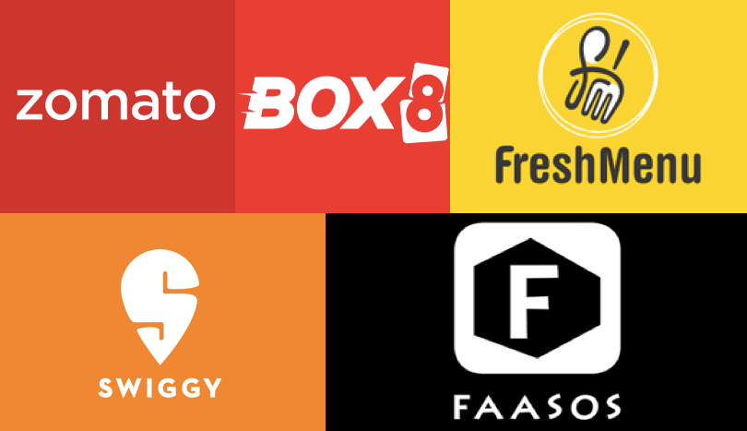
Competitor Analysis Findings:
Key Competitors:
Swiggy
Zomato
FreshMenu

Slide 4
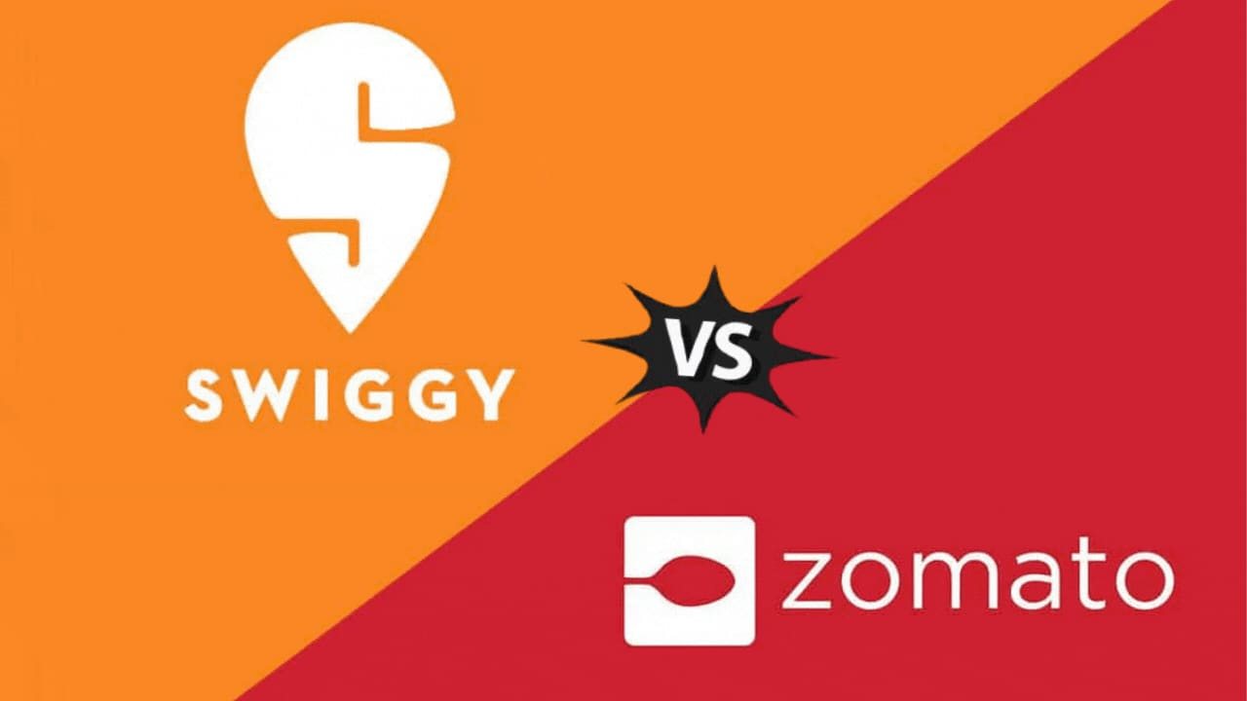
Zomato & Swiggy:
Food Delivery Reviews & Comparisons:
Videos that pit different food orders against each other like "Ordering Biryani from 3 Restaurants – Which One Comes Out on Top?"
Sneak peeks into the inner workings of food delivery services
Fun challenges around delivery speed
Lifestyle & Trend-Based Content:"Food Trends to Watch in 2025"
"Top 10 Most Popular Dishes in India"
What’s Hot in Mumbai vs. Bangalore: A Food Ordering Showdown
Leveraging Influencers for Brand Trust
Swiggy Instamart teams up with food bloggers and celebrities to boost credibility
Zomato enlists stand-up comedians and influencers for entertaining skits.

Slide 5
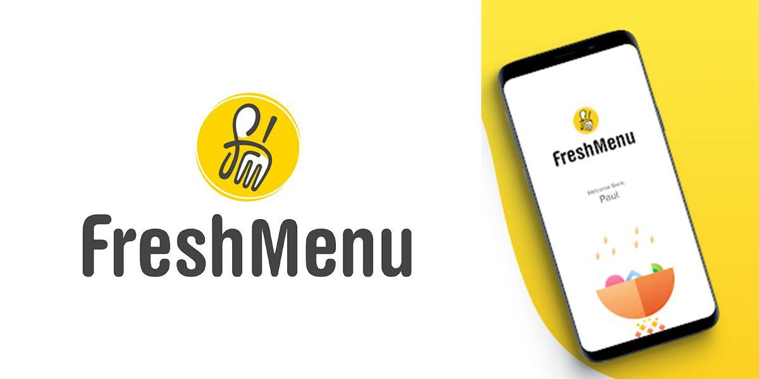
FreshMenu:
Recipe & Cooking Videos:
"How to Create Restaurant-Quality Pasta Right in Your Kitchen"
"Fresh Ingredients vs. Packaged – Which One Tastes Superior?"
Day-in-the-Life Content:
"What It’s Really Like to Work in a Cloud Kitchen"
"A Day in the Life of a FreshMenu Chef"

Slide 6
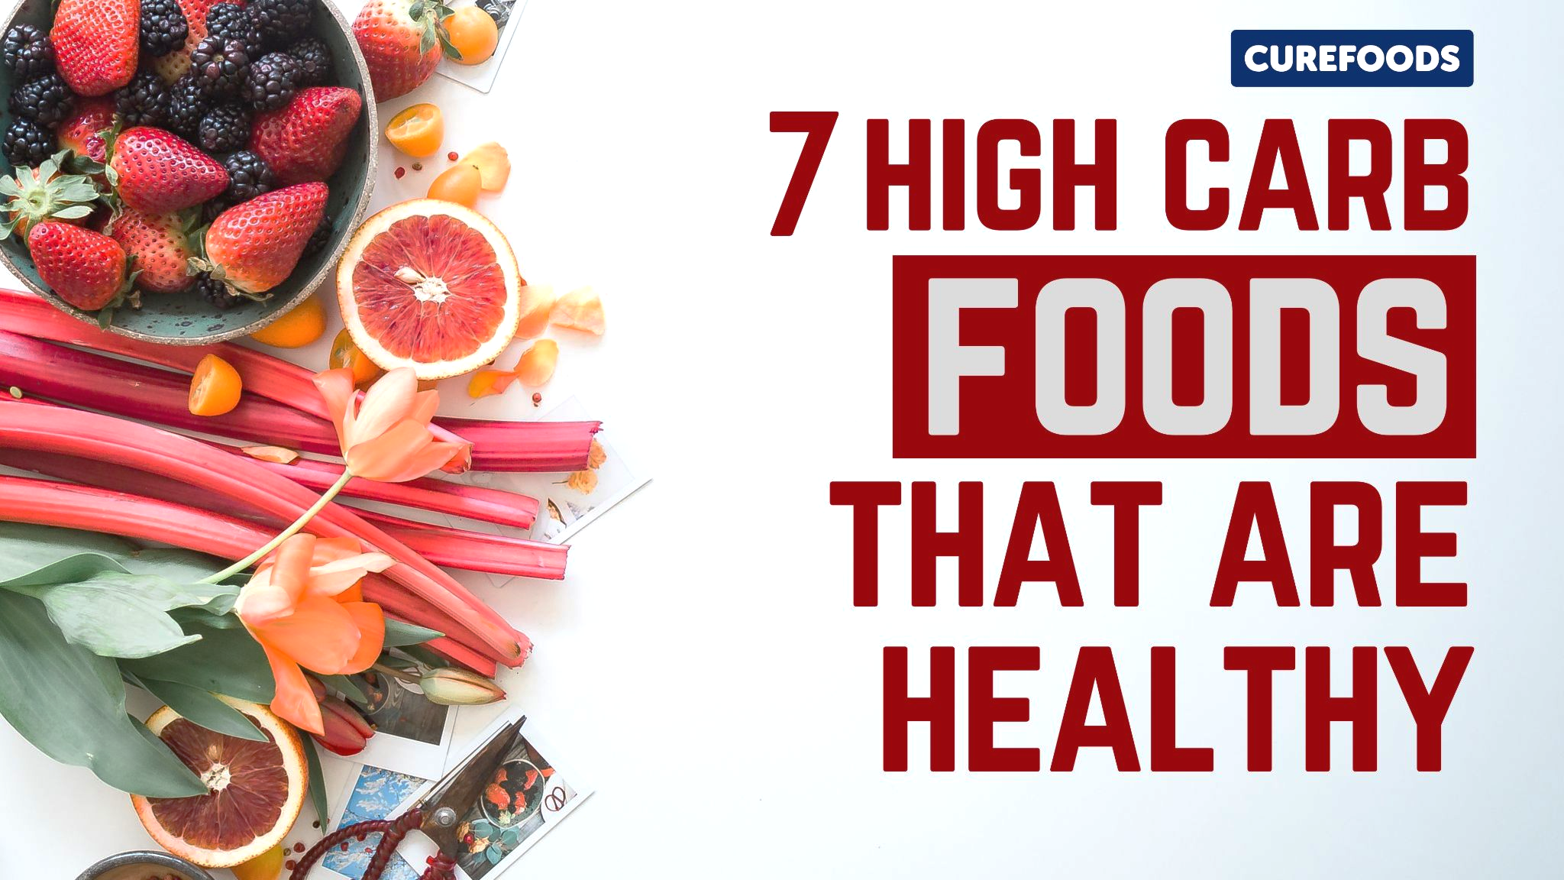
Thumbnail
1.
Title: “High-Carb & Healthy?! 7 Surprising Foods You Need to Try!”
Video Outline & Key Talking Points:
INTRO (0:00 - 1:00) – Busting the myth!
FOOD 1 - 3 (1:00 - 4:00) – Nutrient-packed carbs.
FOOD 4 - 6 (4:00 - 7:00) – Best carbs for energy.
FOOD 7 (7:00 - 8:30) – The underrated super carb.
FINAL THOUGHTS (8:30 - 10:00) – Carbs are not the enemy.

Slide 7

Thumbnail
2.
Title: “Foods That Energize Your Day – Best Breakfasts for a Power-Packed Morning!”
Video Outline & Key Talking Points:
INTRO (0:00 - 1:00) – Why breakfast matters!
OPTION 1 - 3 (1:00 - 4:00) – Quick & Nutritious.
OPTION 4 - 6 (4:00 - 7:00) – Supercharged meals.
BONUS PICK! (7:00 - 8:30) – The ultimate morning booster.
FINAL THOUGHTS (8:30 - 10:00) – Best way to start your day.

Slide 8
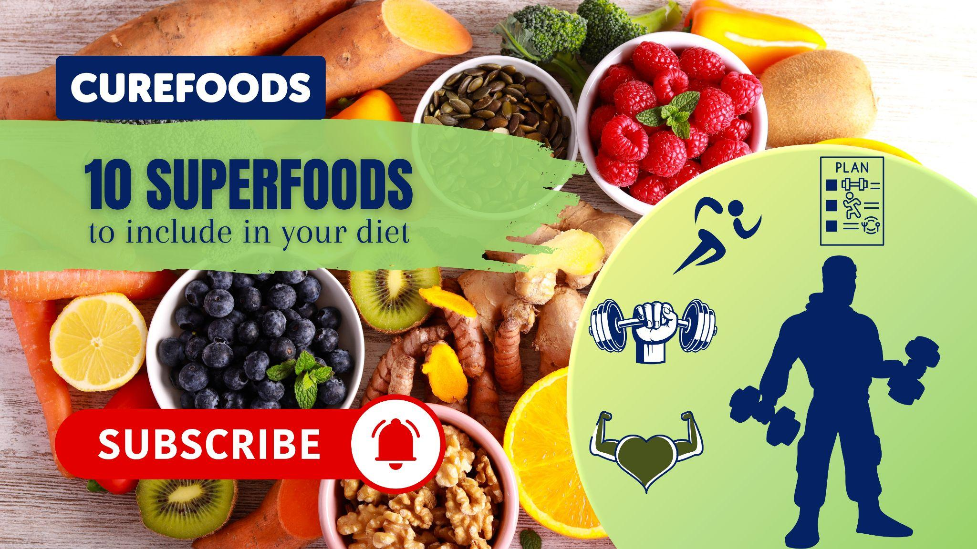
Thumbnail
3.
Title: “10 Superfoods You NEED in Your Diet for Better Health & Energy!”
Video Outline & Key Talking Points:
INTRO (0:00 - 1:00) – Why superfoods matter
SUPERFOODS BREAKDOWN (1:00 - 8:30) – The top 10 list
FINAL THOUGHTS (8:30 - 10:00) – How to include these foods

Slide 9

Thumbnail
4.
Title: “5 DIY Guilt-Free Desserts – Healthy & Delicious Treats!”
Video Outline & Key Talking Points:
INTRO (0:00 - 1:00) – Can desserts be healthy?
RECIPE BREAKDOWN (1:00 - 8:30) – The 5 healthy desserts.
FINAL THOUGHTS (8:30 - 10:00) – Taste test & best pick.

Slide 10
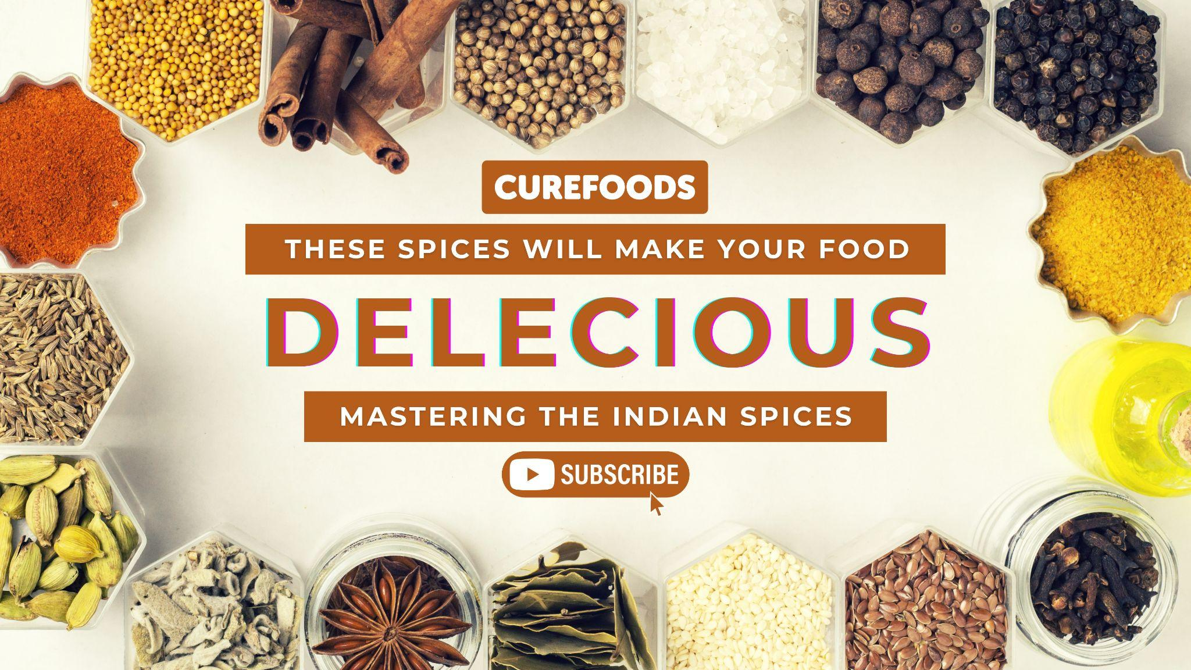
Thumbnail
5.
Title: “Mastering Indian Spices – Elevate Your Cooking!”
Video Outline & Key Talking Points:
INTRO (0:00 - 1:00) – Why spices matter?
SPICE BREAKDOWN (1:00 - 8:30) – Essential Indian spices.
FINAL THOUGHTS (8:30 - 10:00) – How to use them?

Slide 11
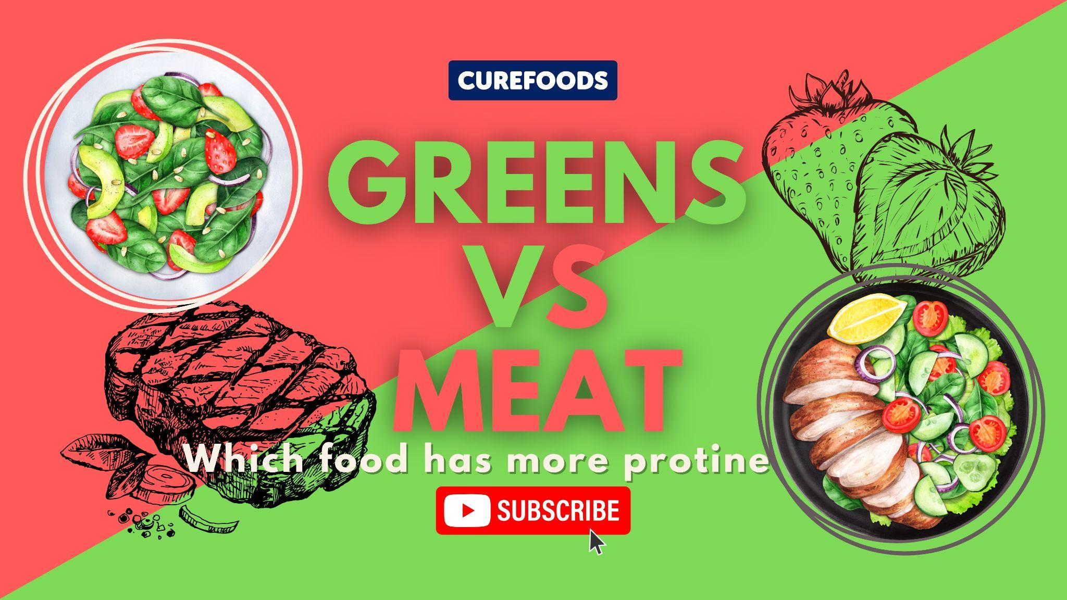
Thumbnail
6.
Title: “Greens vs. Meat – Which Food Has More Protein?”
Video Outline & Key Talking Points:
INTRO (0:00 - 1:00) – The protein debate.
GREENS (1:00 - 4:00) – Can plants give enough protein?
MEAT (4:00 - 7:00) – The classic protein source.
HEAD-TO-HEAD COMPARISON (7:00 - 9:00) – Which one wins?
FINAL THOUGHTS (9:00 - 10:00) – The verdict.

Slide 12
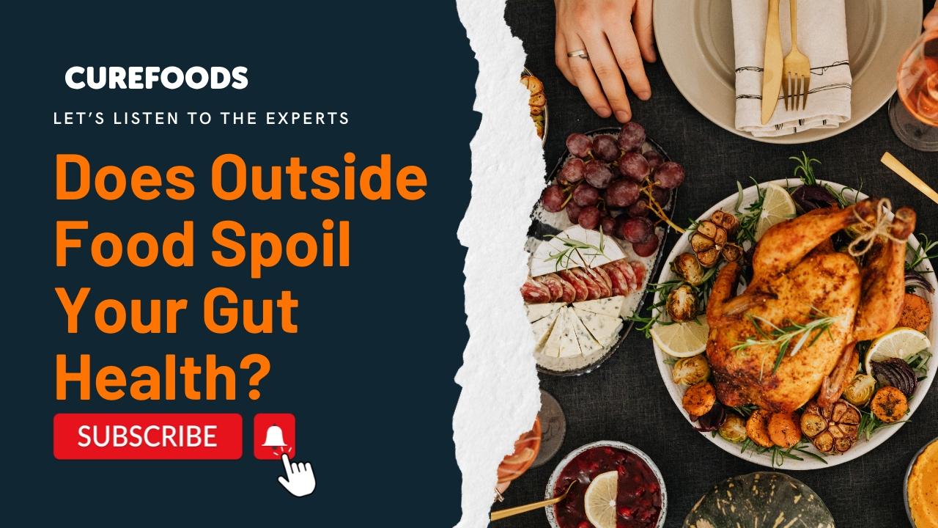
Thumbnail
7.
Title: “Does Outside Food Ruin Your Gut Health? Experts Weigh In!”
Video Outline & Key Talking Points:
INTRO (0:00 - 1:00) – The gut health dilemma
BREAKFAST (1:00 - 3:30) – The morning test
LUNCH (3:30 - 6:00) – Midday meal check
DINNER (6:00 - 8:30) – Ending the day right
FINAL THOUGHTS (8:30 - 10:00) – The final verdict

Slide 13
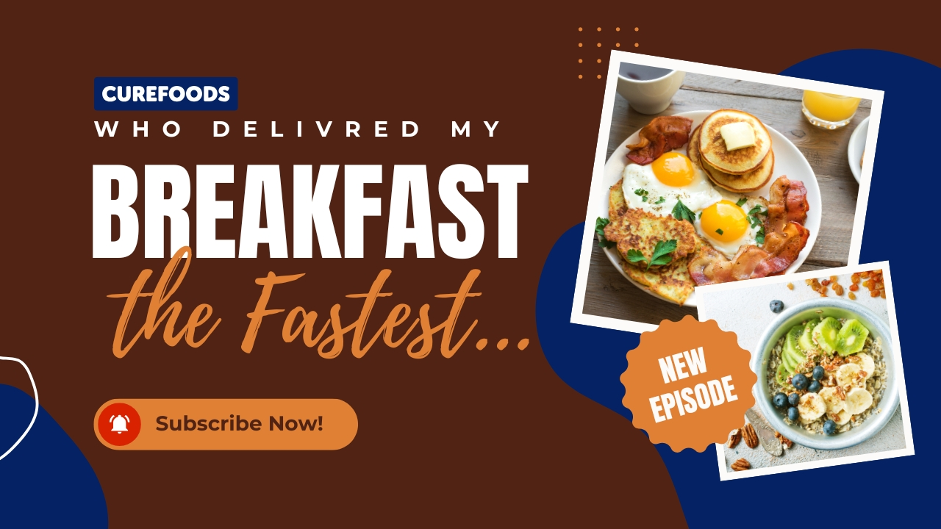
Thumbnail
8.
Title: “I ordered from three different places… who got here first?”
Video Outline & Key Talking Points:
INTRO (0:00 - 1:00) – The breakfast race begins.
ORDERING & EXPECTATIONS (1:00 - 3:30) – placing the orders.
DELIVERY & FIRST IMPRESSIONS (3:30 - 6:00) – The speed test.
TASTE TEST & VALUE CHECK (6:00 - 8:30) – Quality vs. Speed.
FINAL THOUGHTS (8:30 - 10:00) – The final verdict!

Slide 14
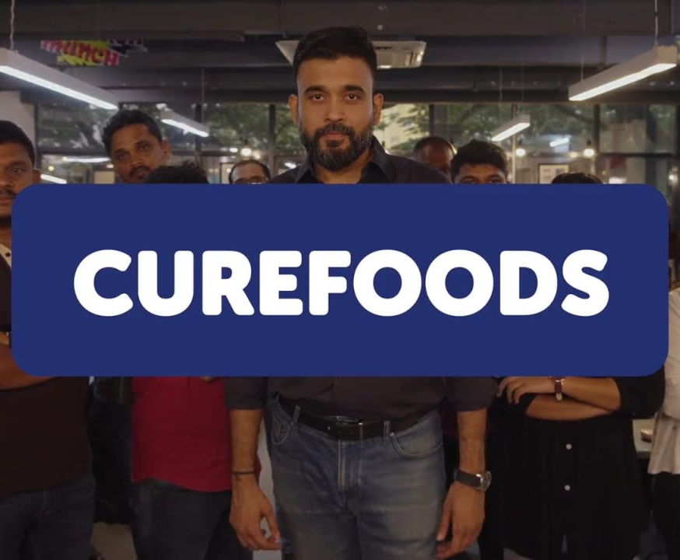
What This Means for Curefoods' YouTube Strategy
Challenge-Based & Interactive Videos
While competitors are busy with "reviews," Curefoods has the chance to spice things up with fun challenges like taste tests, budget meals, and cooking duels.
For instance: "We Cooked With No Utensils… Can It Still Taste Good?"More Personality-Driven Content
While Swiggy and Zomato lean on influencers, Curefoods could create its own unique in-house personality.
Imagine featuring a quirky host or chef who reacts to the latest viral food trends or engages with customers.
Hyper-Local & Regional Food Focus
Instead of just highlighting trends on a broad scale like Swiggy and Zomato, Curefoods can dive deep into specific cities.

Slide 15
Upload Schedule & Performance Tracking
Let’s talk about Posting Frequency:
Timeline: Try to upload a new video every week, aiming for Saturdays at 6 PM.
Best Days to Post: You’ll notice that weekends tend to generate more engagement, particularly when it comes to food-related content.
Now, onto Tracking Performance:
YouTube Analytics (keeping track of watch time and viewer retention).
Engagement Rate (looking at the number of comments and likes).
Click-Through Rate (monitoring how many viewers click after seeing your thumbnail).
Sales Conversion (evaluating how many views actually lead to sales).

